Slide 1
INTRODUCTION TO AWS

Slide 2
AGENDER
History of AWS
Magic Quadrant
Regions and Availability Zones
Regions and Availability Zone Relation
AWS Global Infrastructure
Introduction AWS management console
AWS Free Tier

Slide 3
HISTORY OF AWS
2003 – Chris Pinkman & Benjamin Black present a paper on what Amazon’s own internal infrastructure should look like.
Suggested selling it as a service and prepared a business case.
SQS officially launched in 2004
AWS Officially launched in 2006

Slide 4
HISTORY OF AWS
2007 over 180,000 developers were on the platform
2010 all of amazon.com moved over
2012 First Re-Invent Conference
2013 Certifications Launched

Slide 5
REGIONS AND AVAILABILITY ZONE
Amazon EC2 is hosted in multiple locations world-wide.
These locations are composed of regions and Availability Zones.
Each region is a separate geographic area.
Each region has multiple, isolated locations known as Availability Zones.
Amazon EC2 provides you the ability to place resources, such as instances, and data in multiple locations.
Resources aren't replicated across regions unless you specify do so.

Slide 6
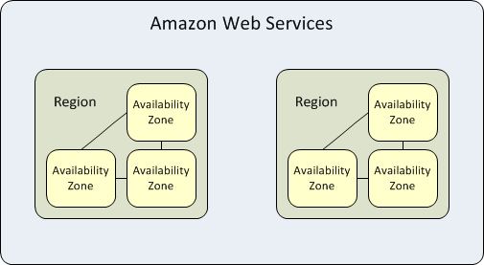
Region and Availability Zone Relation
Each region is completely independent.
Each Availability Zone is isolated, but the Availability Zones in a region are connected through low-latency links.
The following diagram illustrates the relationship between regions and Availability Zones.

Slide 7
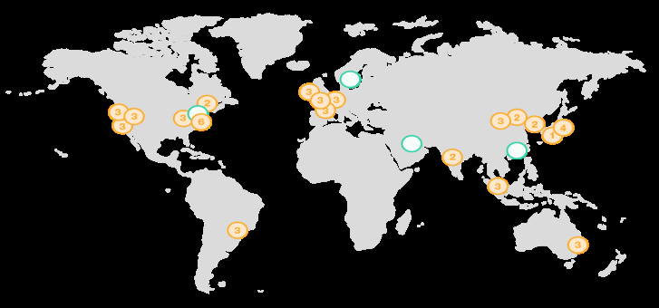
AWS GLOBAL INFRASTRCUTURE
https://aws.amazon.com/about-aws/global-infrastructure/

Slide 8
THANK YOU

